Slide 1
Desktop Monitoring over Local Network
Under the guidance of
Dr. T.P.Sharma
Associate Professor, Computer Science & Engineering Department
Submitted by:
Niharika Ahuja(13559)
Arman Jain (13581)
Anil Kumar(13530)
Anil Chaurasiya(13568)
Abhinandan (13532)

Slide 2
Introduction
We usually come across areas where an admin or department or company head needs to monitor user work.
This monitoring helps the authority to know about any unusual activity or any activity not supposed to be done in office premises, which is done by the employee.
To make this monitoring easy and effective, we have come up with an On Demand Authority system that monitors a PC on authority demand.

Slide 3
Remote PC monitoring needs a working internet connection.
This application is our effort to provide a monitoring facility to people like faculty members in educational institutions, lab heads, managers in the organization to monitor the students or employees in a timely fashion by the medium of real time screenshots.

Slide 4
Technologies Involved
Go Language
Scrot

Slide 5
Features of Go Language
Free and open source programming language created at Google in 2007.
Statically typed, fast compiled language designed for modern development
Produces binary executables, like C++
Cross platform

Slide 6
Powerful at Concurrency with inbuilt primitives.
Concurrency is baked nicely into the language.
Go has the very simple ‘go’ keyword, which is to say “go do this function in the background”, channels, which allow for buffered references of data for processing as well as parallelism by running go-routines on multiple cores asynchronously.
Developers can write programs that takes full use of the CPU available.

Slide 7
Scrot
An open source, powerful and flexible, command line utility for taking screen shots of your Desktop, Terminal or a Specific Window manually or automatically .
It supports multiple image formats (JPG, PNG, GIF, etc), which you can specify while taking screen shots by using the tool.

Slide 8
Features Of Scrot
With scrot we can take screen shots easily without any additional work.
We can also optimize the quality of the screen shots image (with the -q switch, followed by a quality level between 1 and 100. The default quality level is 75.
It is very easy to installation and use.
We can capture a specific window or a rectangular area on the screen with the help of switch.
Can get all screen shots in a particular directory and also can store all screen shots

Slide 9
"
Installing Scrot in linux
$ sudo apt-get install scrot
command to take screen shot
scrot ‘%Y :%m :%d :%H :%M :%S.png’ –e ‘mv $f ‘DIRECTORY_PATH’ .

Slide 10
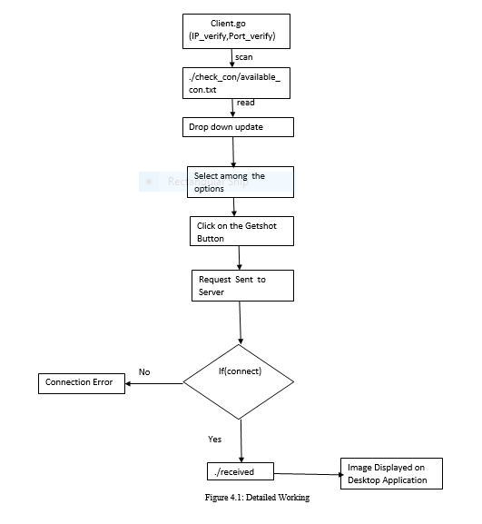
Detailed Working

Slide 11
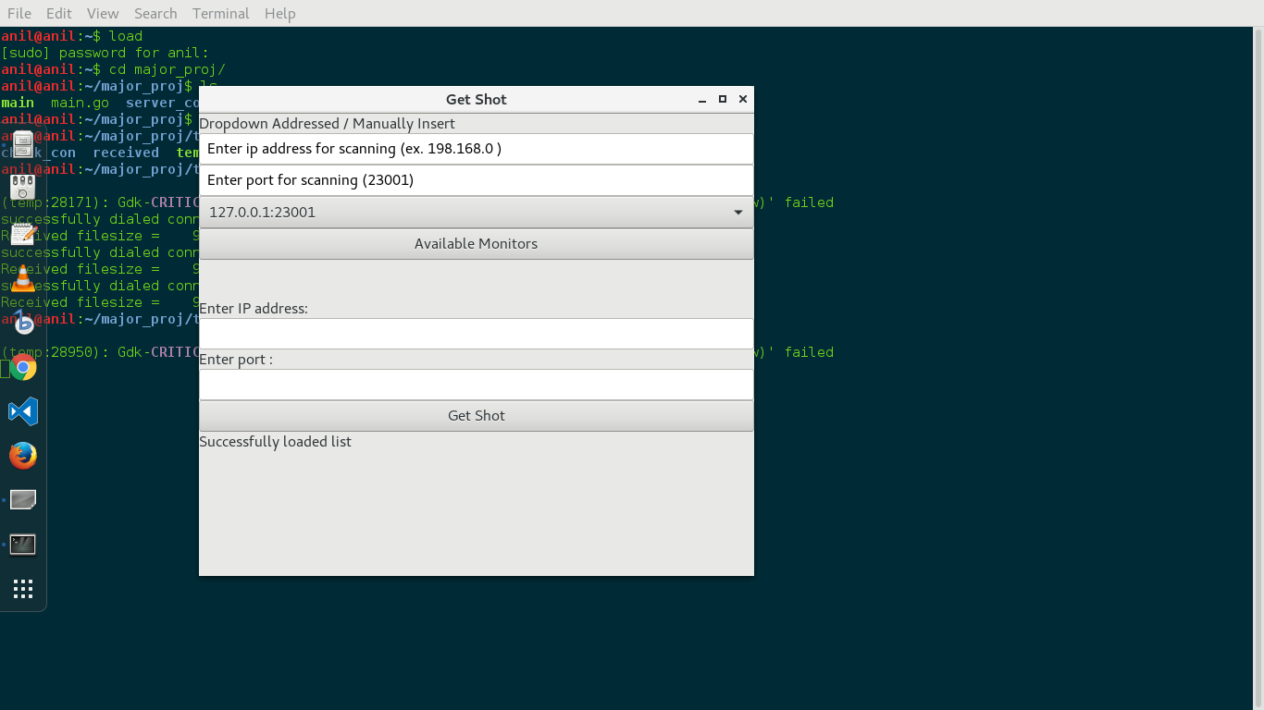
Initiation
Upon initiation of the application, it gets the list of all the
available PCs on the network and stores their corresponding IP
addresses and port number in a file.

Slide 12
Drop Down Menu
The dropdown menu “Available Monitors” shows the
list of all the online PCs whose IP addresses are
stored on the startup of application. The admin can
chose from any of these available host to get and
then can get a screenshot.

Slide 13
Manual Text Field
There are two text fields in the application:-
Enter IP address-Here a recognized IP address of any of the PC on the network can be entered for the retrieval of the screenshot.
Enter Port-Here corresponding port number to the IP address has to be entered.

Slide 14
Get Shot
After successfully choosing one of the available PC’s
or entering a valid IP address and port number, this
button can be used to get the screenshot which pops
up in a separate window on the admin’s screen.

Slide 15

Status Label
Below the Get Shot button, there is a status label which shows the error like-
Enter valid inputs on entering an unrecognized IP address as shown in Figure 5.2 and it also shows success on the retrieval of the screenshot.

Slide 16
How to make a server
Create a socket with the socket() system call.
Bind the socket to an address using the bind() system call. For a server socket on the Internet, an address consists of a port number on the host machine.
Listen for connections with the listen() system call.
Accept a connection with the accept() system call. This call typically blocks the connection until a client connects with the server.
Send and receive data using the read() and write() system calls.

Slide 17
Process at server side
Listens a request from the client.
On receiving a request from the client, it takes screen shot using shell script(take_shot.sh) and sends image to that client.

Slide 18
Advantages
Admin can check that whether the employee is doing assigned work on the system or not.
Admin can get this on just a click.
Admin will get information about all systems where this is implemented.

Slide 19
Limitations
Each system should have internet connectivity.

Slide 20
Applications
Can be used in a MNC where boss does not have time to keep an eye on every activity of employee.
Can even be used in cyber cafe where admin can check every user is not using for malfunction.

Slide 21
Scope
PC monitor can be extended to the concept of PC control. The admin can hold or shutdown any of the employee PC’s with the Desktop Application.

Slide 22
References
PC Control Over Internet | NevonProjects, Nevonprojects.com, 2016.
J. O'Toole, “Golang and why it matters,” Medium, 2016. [Online]. Available: https://medium.com/@jamesotoole/golang-and-why-it-matters-1710b3af96f7. [Accessed: 13-Dec-2016].
S. Singh and V. Posts, "Scrot: A Command Line Tool to Take Desktop/Server Screenshots Automatically in Linux", Tecmint.com, 2016.
G. Vlasselaer, "Golang transfer a file over a TCP socket - Mr.Waggel", Mrwaggel.be, 2016.

